Slide 1

AB InBev Strategic Market Analysis on the Impact of MicroBreweries to Market Share
By: Team DataTex

Slide 2
Introduction
As of 2015 AB InBev has a 45.8% share of the US Beer market
Worldwide market shares for InBev have been steadily increasing.
Argentina 76.7%
Brazil 67.5%
South Korea 57.0%
Mexico 58.2%
Belgium 55.5
Merger with Anheuser-Busch has made AB InBEV the largest brewer in America
Overall Beer Consumption up from prior year.
US market share down 1.7% when compared to 2014 data.
This may be due to the impact of MicroBreweries and changes in US beer preference.
https://www.statista.com/statistics/199024/ab-inbev-beer-market-share-by-country/
Notes:
Argentina 76.7%,

Slide 3
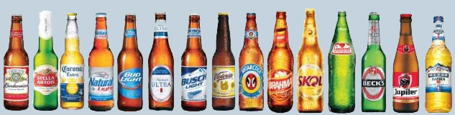
The Data
Breweries <- read.csv("C:/CaseStudy1/Breweries.csv", header = TRUE, sep = ",")
DataSet of 558 US Microbreweries
Beers <- read.csv("C:/CaseStudy1/Beers.csv", header = TRUE, sep = ",")
Dataset of 2410 US Craft Beers
Notes:
The source of the data used in the analysis were from the Breweries and Beers csv files. This data provided information on 558 Microbreweries as well as 2410 US Craft Beers.

Slide 4
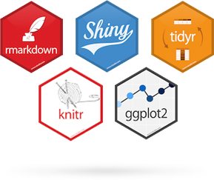

Analysis Tools for R-Studio
library(dplyr)
library(knitr)
library(rvest)
library(ggplot2)
library(psych)
library(maps)
library(plyr)
Notes:
The Analysis that we are providing was performed in R with the use of dplyr, knitr, rvest, ggplot2, psych, maps, and plyr libraries.

Slide 5
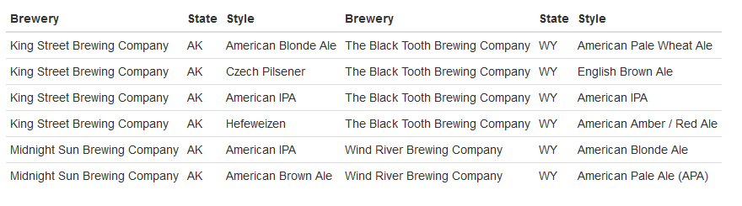




From Alaska to Wyoming A Revolution is Brewing
beers <- BeerData[c(1,3,5)]
Alaska <- head(beers,7)
P1 <- Alaska[2:7, ]
Wyoming <- tail(beers)
P2 <- Wyoming[1:6, ]
knitr::kable(list(P1, P2), row.names = FALSE)
Notes:
Now according to data from the Brewer’s Association, the number of microbreweries in the US jumped from 620 in the year 2010 to 2,626 in year 2015.
https://www.brewersassociation.org/statistics/number-of-breweries/.
A pattern is emerging in the Brewing business.

Slide 6
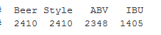
Data Driven Brewing
MicroBrewers are making complex and innovative beers.
All 2,410 beers had a specified style and type
97% of the beers had a specified ABV
58% of the beers had a specified IBU.
colSums(!is.na(BeerData[4:7]))
Notes:
Read slides

Slide 7
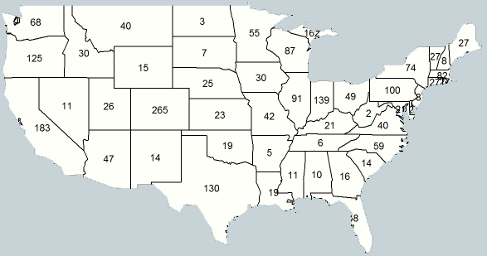
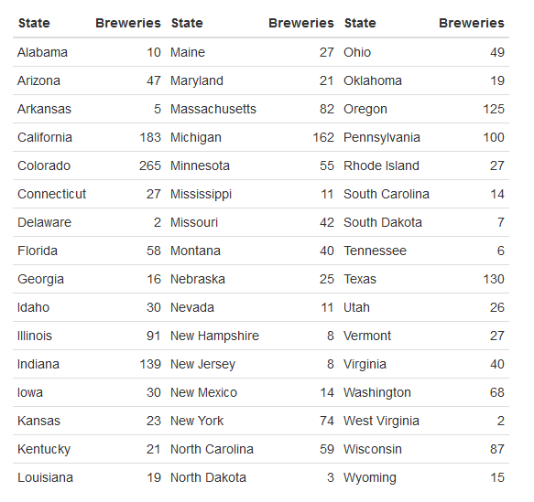
Breweries Per State
BreweryState <- count(dataset_merge,"State")
BreweryState <- BreweryState[-c(1,8,12), ]
BreweryState <- BreweryState[order(BreweryState$State), ]
States <- States[-c(2,11), ]
States <- States[order(States$State), ]
BreweryState$StateLong <- States$StateLong
BrewStateLst <- BreweryState[c(3,2)]
BrewStateLst <- BrewStateLst[order(BrewStateLst$StateLong), ]
colnames(BrewStateLst) <- c("State", "Breweries")
L1 <- BrewStateLst[1:16, ]
L2 <- BrewStateLst[17:32, ]
L3 <- BrewStateLst[33:48, ]
knitr::kable(list(L1, L2, L3), row.names = FALSE)
Notes:
Of specific interest is the location of these Breweries.
From the data, the specific brewery count per state was generated and the location of where those counts reside is shown here on the map.
Rather large counts of breweries are emerging in different parts of the US.

Slide 8
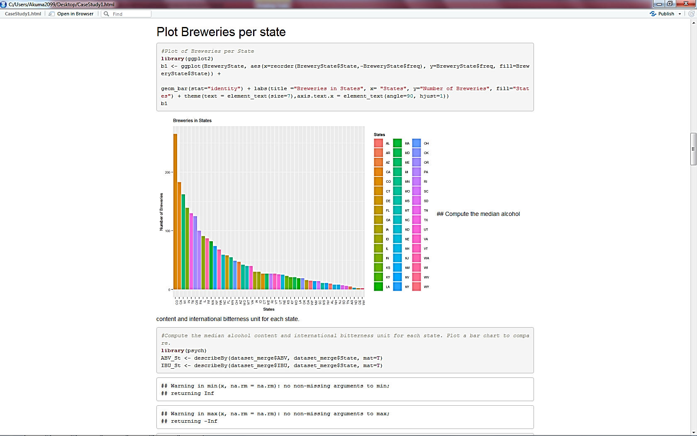
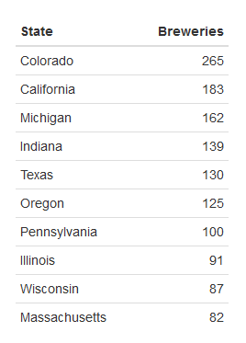
Breweries Per State
library(ggplot2)
b1 <- ggplot(BreweryState,
aes(x=reorder(BreweryState$State,- BreweryState$freq), y=BreweryState$freq, fill=BreweryState$State)) + geom_bar(stat="identity") + labs(title
="Breweries in States", x= "States", y="Number of Breweries", fill="States") + theme(text = element_text(size=7), axis.text.x = element_text(angle=90, hjust=1)) b1
Notes:
Taken from another view, when the data is sorted in descending order, we see that the largest amount of breweries were found in the state of Colorado, followed by California and Michigan. Now, my colleague Karen will now go into some further analysis of the data.

Slide 9
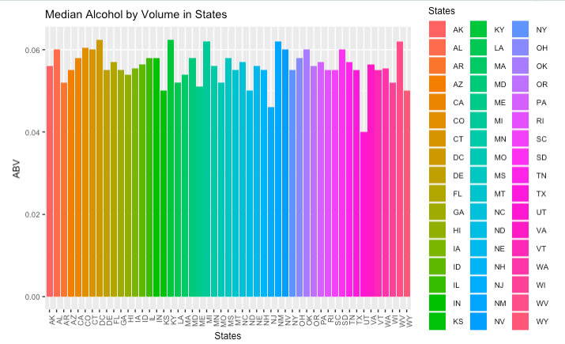

Median ABV by State

Slide 10
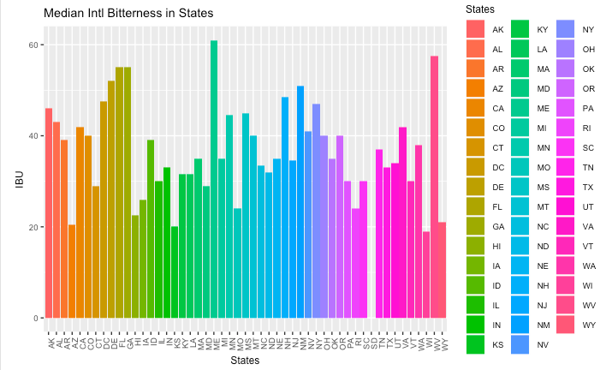

Median IBU by State

Slide 11
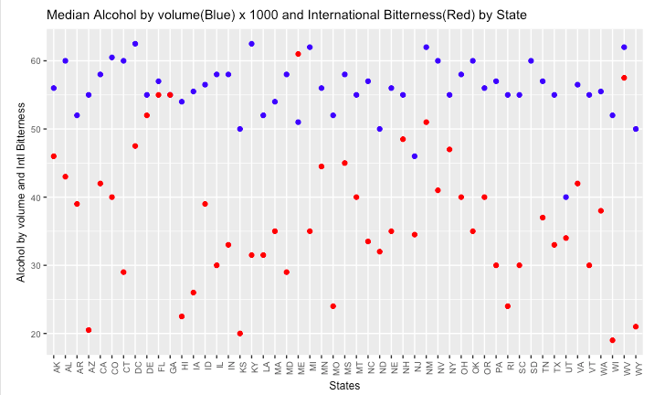
Median IBU and ABV by State
This view compares median IBU and ABV levels by state
Differing variability in IBU
Greater concentration of lower IBU levels

Slide 12
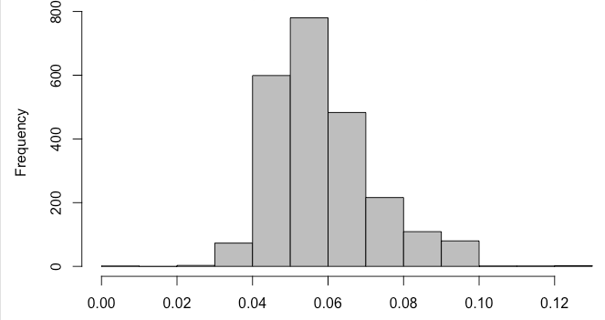
ABV
Minimum | 1st Quartile | Median | Mean | 3rd Quartile | Maximum
0.001 | 0.05 | 0.056 | 0.059 | 0.067 | 0.128

Slide 13
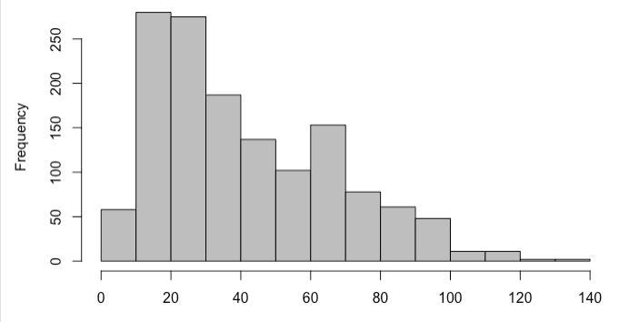
IBU
Minimum | 1st Quartile | Median | Mean | 3rd Quartile | Maximum
4 | 21 | 35 | 42.71 | 64 | 138

Slide 14
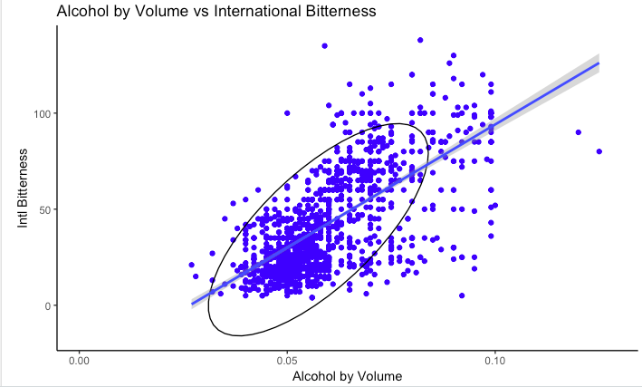
ABV vs. IBU
Positive, linear relationship between ABV and IBU
Fanning shape in scatterplot indicates less variation in IBU for beers with lower alcohol content
Bitterness varies more greatly for beers with higher alcohol content

Slide 15
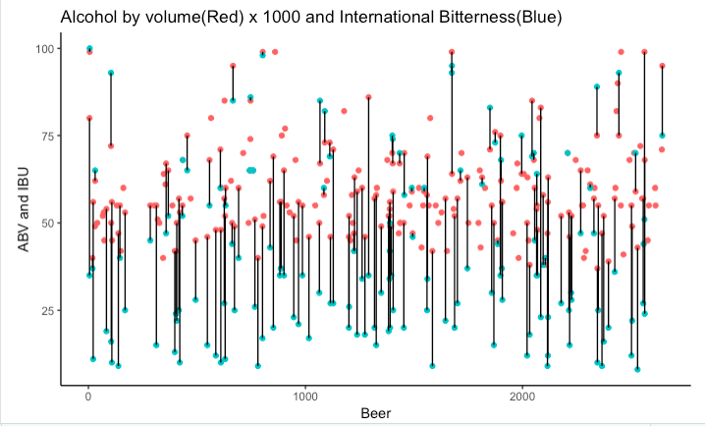
ABV vs. IBU
Random sample of 250 beers
Line segments show distance between ABV*1000 and IBU
Not a clear relationship

Slide 16
Conclusions
Competition is growing for AB InBev.
Competitors have beers with a wide variety of IBU levels, and these levels also vary by state.
This suggests that tastes differ in different markets, and also that tastes are expanding from just a singular style of beer.
To compete, InBev should diversify their beer offerings, even regionally. Most beers tend to have similar alcohol content levels, although some variation in ABV is another dimension that can add to InBev’s beer profile.
AB InBev should strategically position themselves to meet the expanding consumer demand.

